Slide 1

Graduate Record Examination
Presented by: Mahsa Forouzesh

Slide 2
What we will cover today?
Overview of the GRE General Test
Registration tips
What to expect on test day
Getting and sending your scores
Tools to help you prepare
References

Slide 3
Overview
GRE Subject tests
Biology, Chemistry, Literature in English, Mathematics, Physics, Psychology
Composed of three sections:
Analytical Writing
Verbal Reasoning
Quantitative Reasoning
There is no negative marking
All graduate schools in US, some schools in Canada and Europe
Low scores might be ignored for a strong applicant

Slide 4
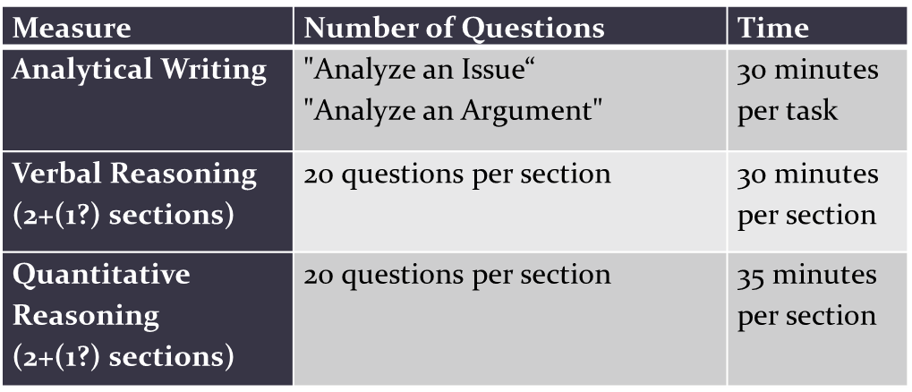
GRE Computer-Delivered General Test

Slide 5
Overview
The test also includes:
Either an unscored section or a research section that does not count toward your scores
-If you get an unscored section, you will not know which one it is, so try your best on all the sections
-If you get a research section, it will always be last and will be clearly marked
Approximate total testing time = 3 hours and 45 minutes (plus timed breaks)

Slide 6
Registration Tips
Register early
Cost: $205, Late:$230 (Credit Card, tehranpayment.com , … )
Reschedule no later than four days before your test + $50 penalty.
To register, you will need to create an ETS Account You can do so at www.ets.org/mygre
-You will also use this account to view your official scores online when they are available
The name you use when registering MUST exactly match your ID documents

Slide 7
What to expect on the test day
Get to the test center early
You can approach the test using more of your own personal test-taking strategies
Within each timed section of the test you can:
-Change your answers
-Mark questions
-Skip questions and return to them
-Navigate freely

Slide 8
Getting and sending your scores
Three scores are reported on the following scales:
Analytical Writing: 0-6 (in half-point increments)
Verbal: 130-170 (in 1-point increments)
Quant: 130-170 (in 1-point increments)
Unofficial scores at test center ( Verbal and Quant)
Valid for five years
Official scores through your ETS account
About 10–15 days after test day, you can view your official scores online
Select “Order Additional Score Reports” to send official copies to institutions after test day.
Putting your best scores forward with the ScoreSelect option
If you need to try again you can retake the test every 21 days

Slide 9
1. Analytical Writing
The Analytical Writing section measures your ability to:
articulate complex ideas clearly and effectively
support ideas with relevant reasons and examples
examine claims and accompanying evidence
sustain a well-focused, coherent discussion
control the elements of standard written English
There are two writing tasks:
Analyze an Issue–Requires you to analyze an issue and develop an argument with reasons and/or examples to support your position
Analyze an Argument–Requires you to assess the logical soundness of a given argument according to the specific task directions
Essay responses are typed on computer
Basic functions include: insert text, delete text, cut and paste, and undo the previous action

Slide 10
1.Analytical Writing
Review the scoring guides for each task to gain a deeper understanding of how readers evaluate essays and the elements they are looking for in an essay.
Practice writing under timed conditions.
Pay close attention to the specific task directions, and make sure that your essay response addresses the specific instructions.
Leave a few minutes at the end of each task to read what you have written and make any revisions that you think are necessary and to check for obvious errors.

Slide 11
2.Verbal Reasoning
Assesses your ability to analyze and evaluate written material and recognize relationships among words and concepts.
Assesses your ability to understand what you read and how you apply your reasoning skills
Question types include
Reading Comprehension
Multiple Choice –select one answer choice
Multiple Choice –select one or more answer choices
Text Completion
Sentence Equivalence
Try to fill in blanks with your own words and find answer choices that match.

Slide 12
Multiple Choice

Slide 13
Multiple Choice

Slide 14
Text Completion Question

Slide 15
Sentence Equivalence Question

Slide 16
3.Quantitative reasoning:
Assesses your ability to interpret and analyze quantitative information and solve problems using mathematical models
Question types include:
Quantitative Comparison
Multiple Choice, select one answer choice
Multiple Choice, select one or more answer choices
Numeric Entry
Learn English mathematical terminology.
Take a few sample tests, and you will succeed.

Slide 17
3.Quantative reasoning:
Focuses on basic mathematical skills and elementary mathematical concepts(Arithmetic, Algebra, Geometry, Data analysis)
The computer selects the second section of a measure based on your performance on the first section.
Within each section, all questions contribute equally to your final score.
Both sections are important, since the final score on each measure is based on the total number of correct answers and the level of difficulty of the questions.

Slide 18
Multiple Choice

Slide 19
Quantitative Comparison Question

Slide 20
Numeric Entry Question

Slide 21
References
GRE vocabulary:
Barron's 800 Essential Word List – GRE
Barron's 1100 Words You Need to Know
Barron's GRE, 3500 Basic Word List
JMEMORIZE professional Leitner box software
Writing:
ETS pool of Argument/Issue topics (search topics on the web)
Quant:
Magoosh GRE videos https://gre.magoosh.com/lessons
Manhattan GRE books
Check out the ETS website https://www.ets.org/gre
There are useful GRE General Test preparation materials which by the way are free☺
PowerPrep Online practice test

Slide 22
Thanks…..

